Slide 1

Biometrics Final Project
Mason Barlow and Alex Searle

Slide 2
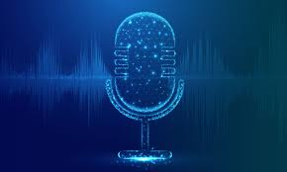
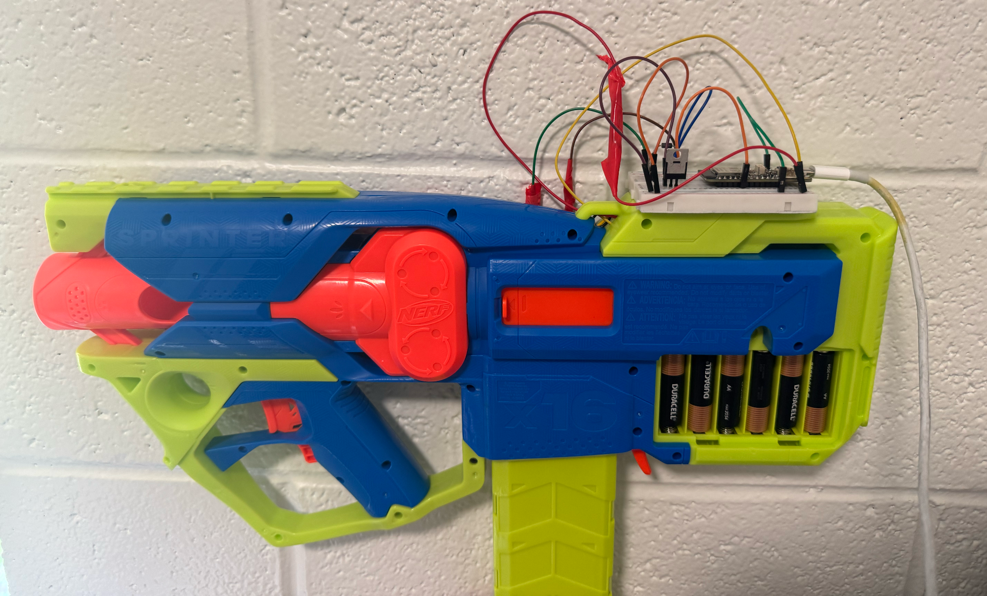
Project Overview
Biometric:
Speaker Recognition
System Process:
1. Sound Sample Collection
2. Preprocessing
3. Transformer Feature Extraction Model
4. Similarity Scoring
5. Decision Implementation
Fun Application:
Smart Toy Nerf Blaster

Slide 3

Sample Collection
Our system collects sound directly from the computer microphone, which is where all the processing is done.

Slide 4
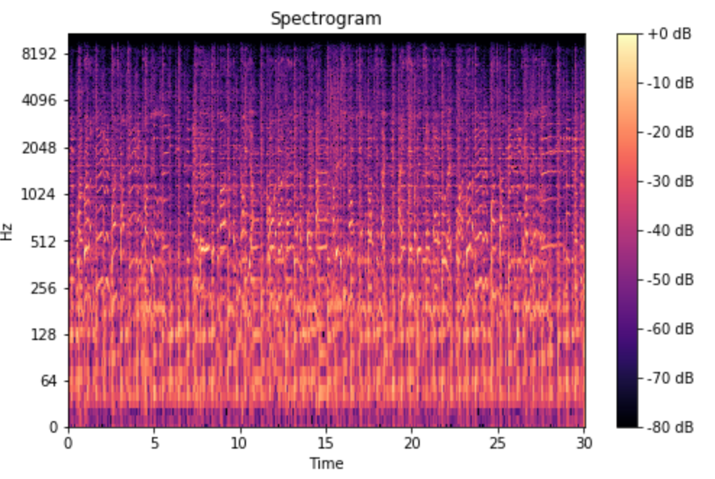
Preprocessing (HomeGrown)
Steps:
Converting to Tenser
Resampling to 16kHz
HomeGrown and Transfer model expects 16kHz
Convert to log mel spectrogram for homegrown

Slide 5
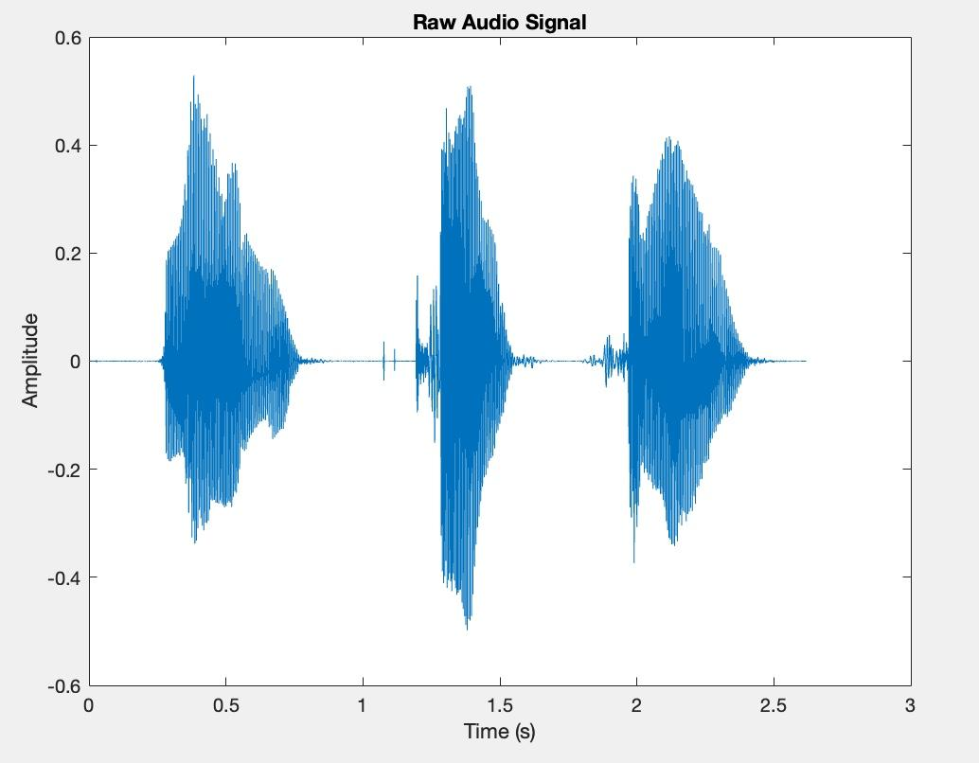
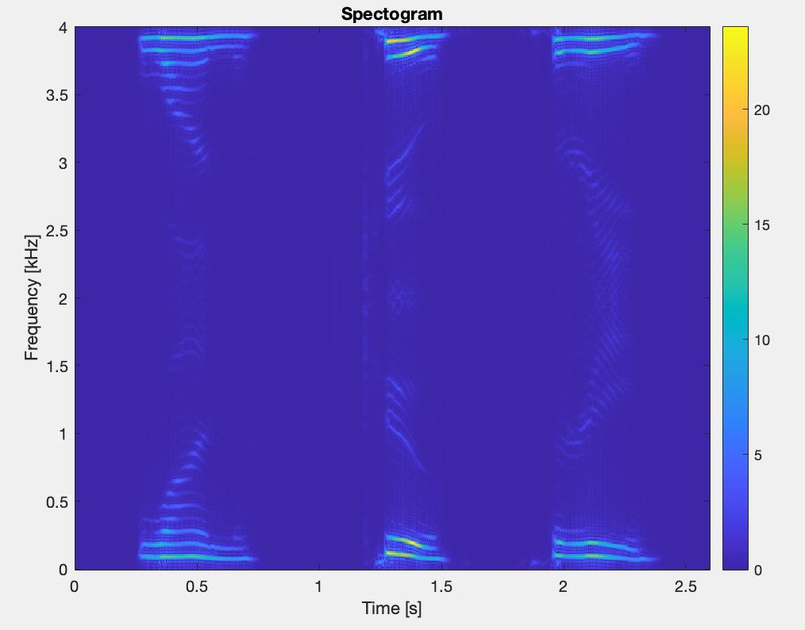
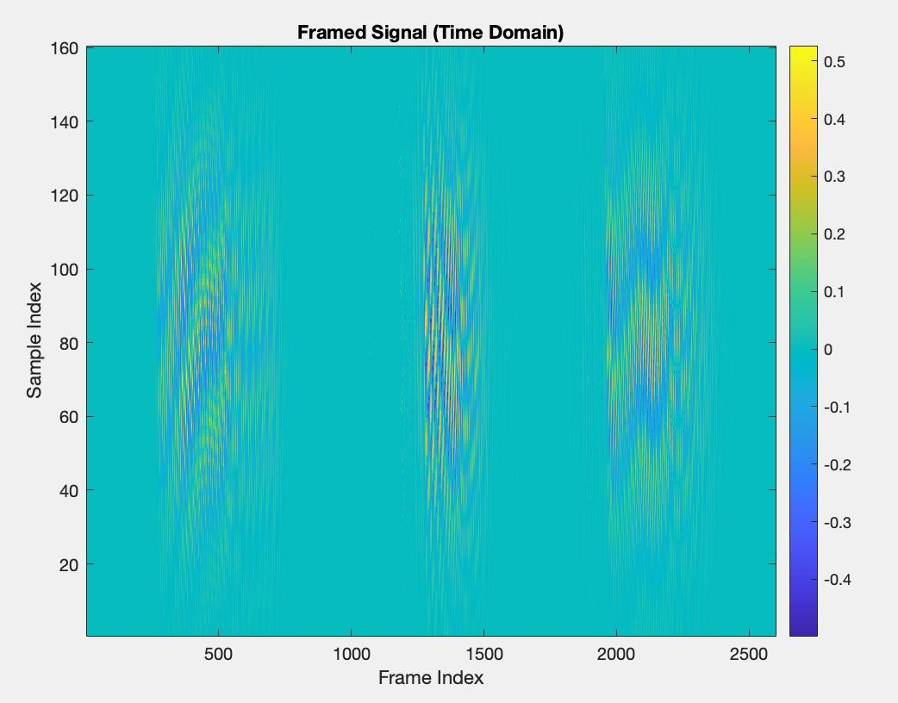
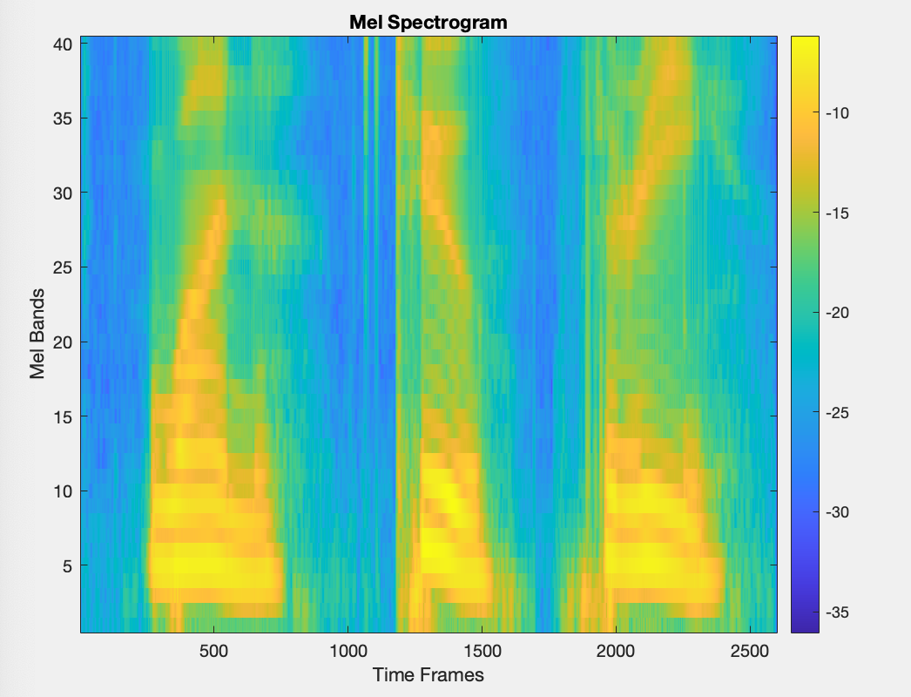
What is a Mel Spectrogram
A Mel Spectrogram is a specific graph showing frequencies based on the Mel scale:
Framing the Signal into a matrix of short segments of the audio file.
FFT is taken on windowed segments changing the signal into the frequency domain
Within this stage it is important to remember that when using the FFT the signal can and will alias.
The system is then converted into the Mel scale giving a much better image for learning models and mimics human hearing more effectively
This is done through the use of the Mel Filter Banks, which is a set of overlapping triangular filters.

Slide 6
Fine Tuned Feature Extraction
Model: WavLM
Input 16kHz audio sample
Pass through WavLM feature extractor
Pass through model
Output: 256 dimension vector
Dataset: Voxceleb

Slide 7
Homegrown Feature Extraction
Architecture: Conv1d(128) -> Conv1d(128) -> Conv1d(256) -> Transformer Encoder -> Feature Vector
Inputs: Log mel spectrogram
Outputs: 256 dimension vector

Slide 8
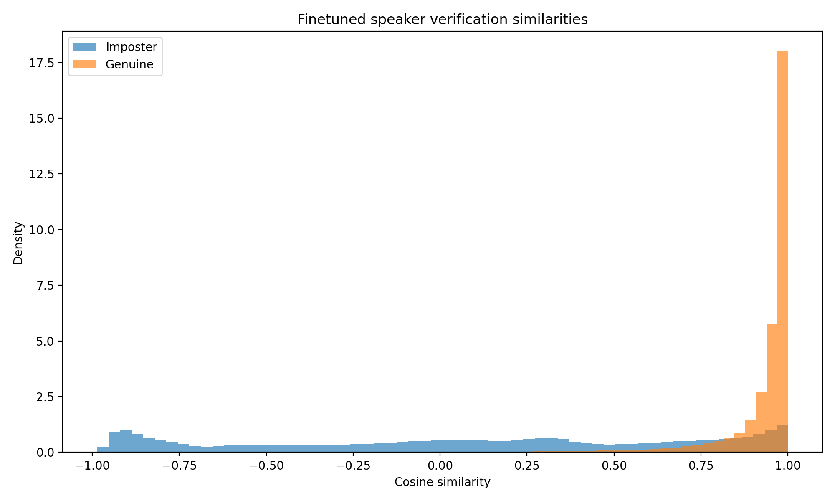
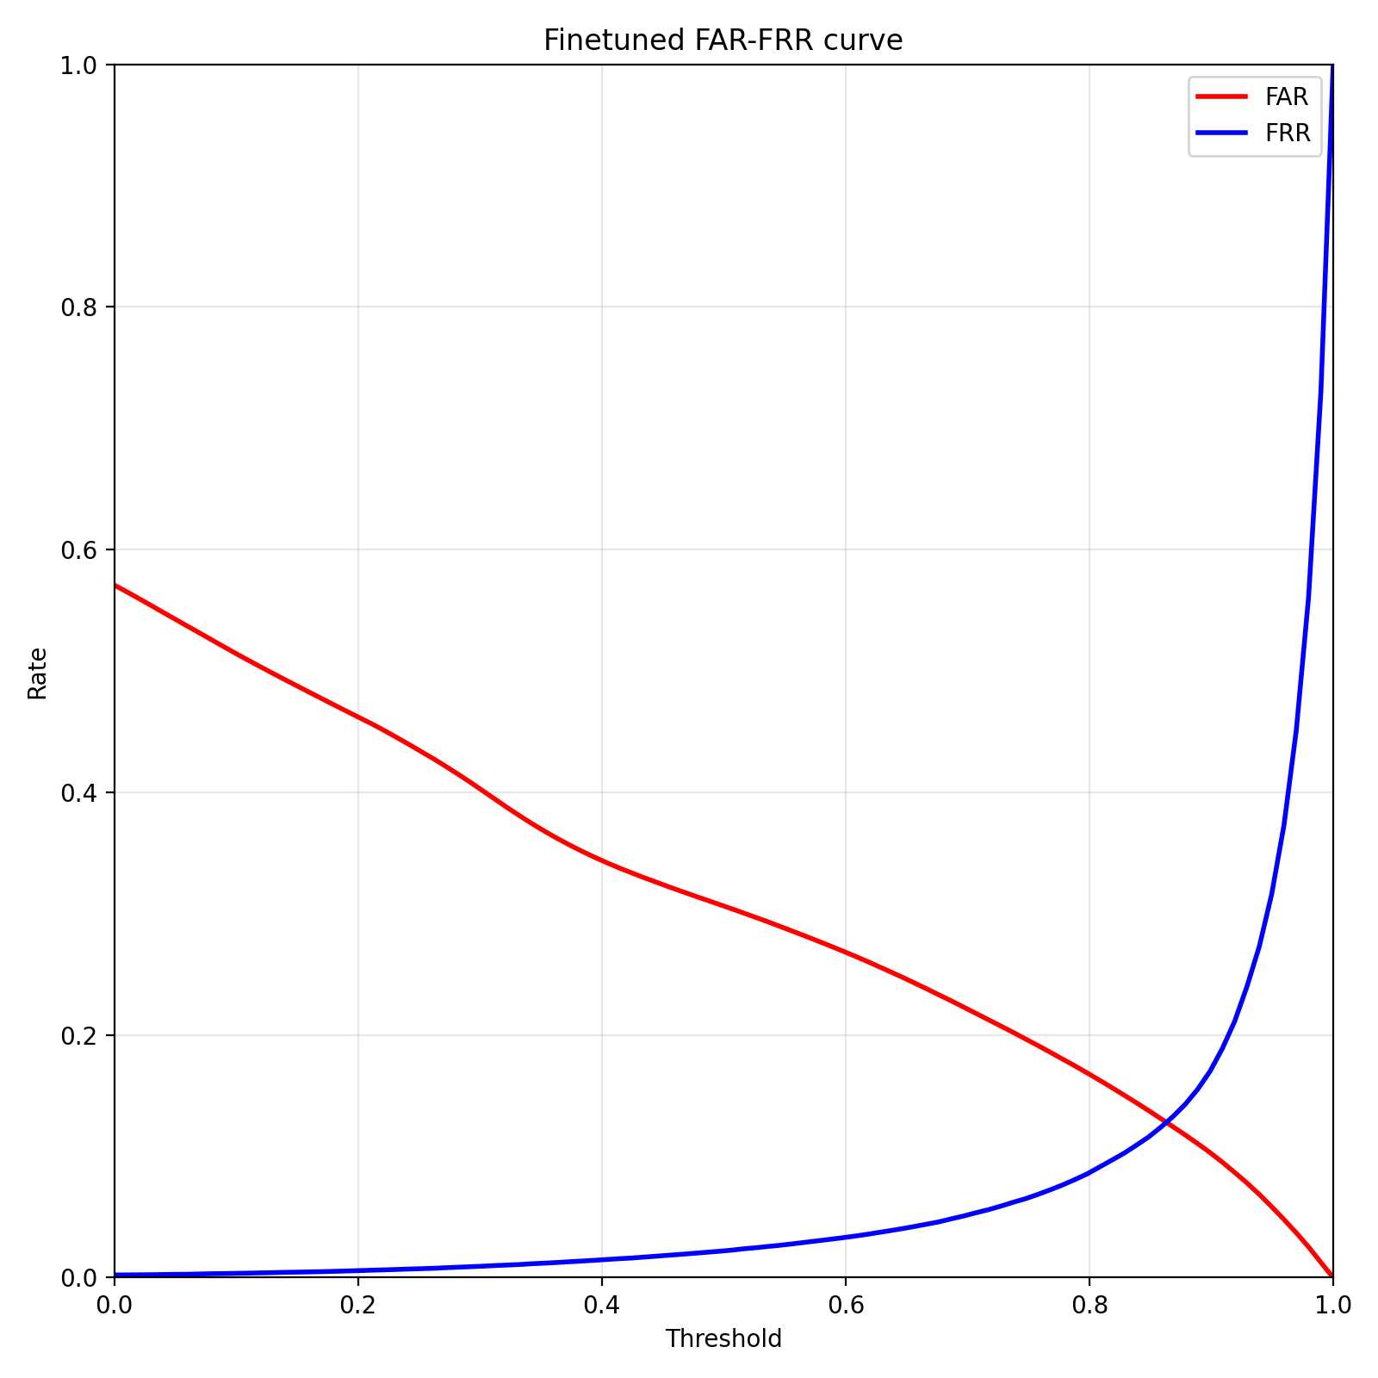
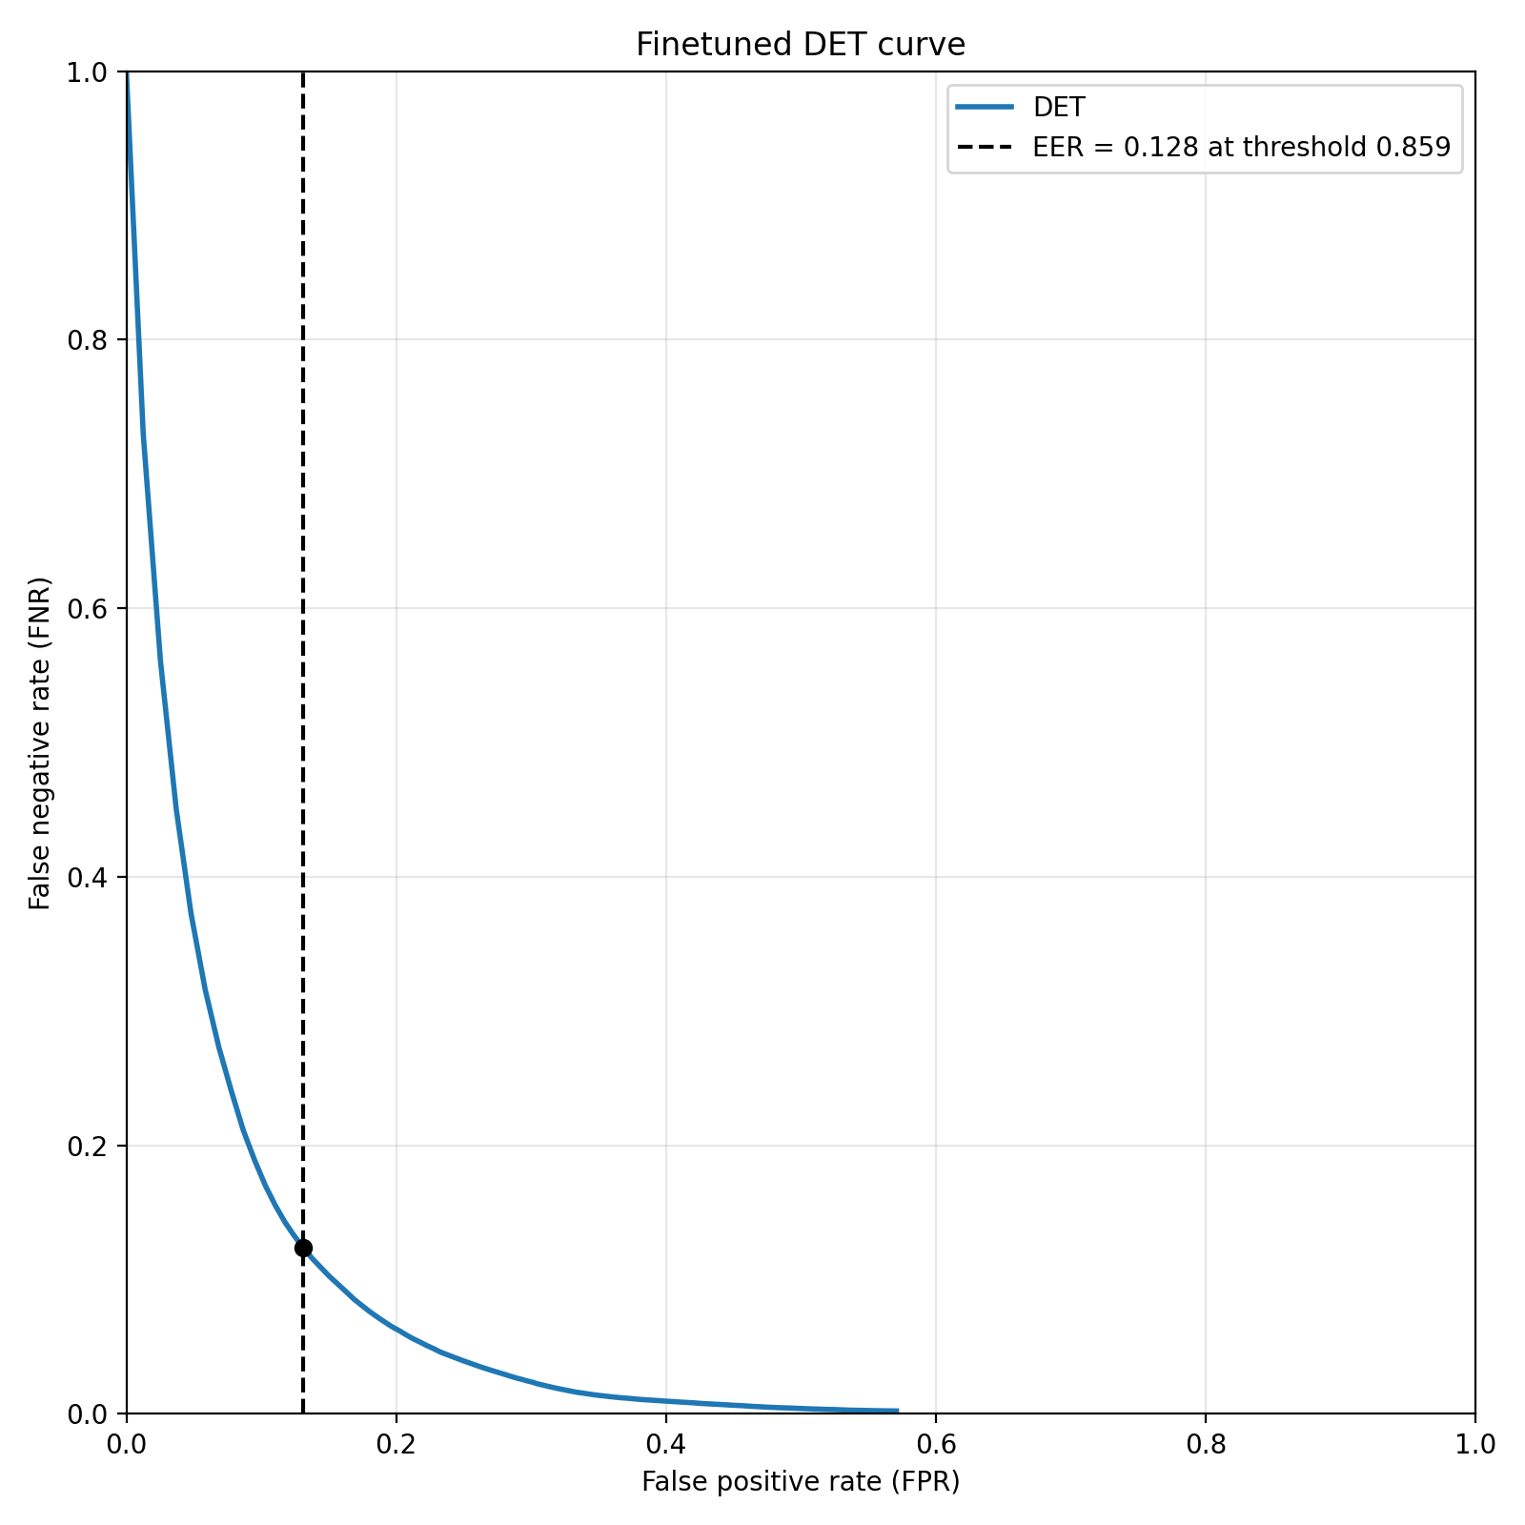
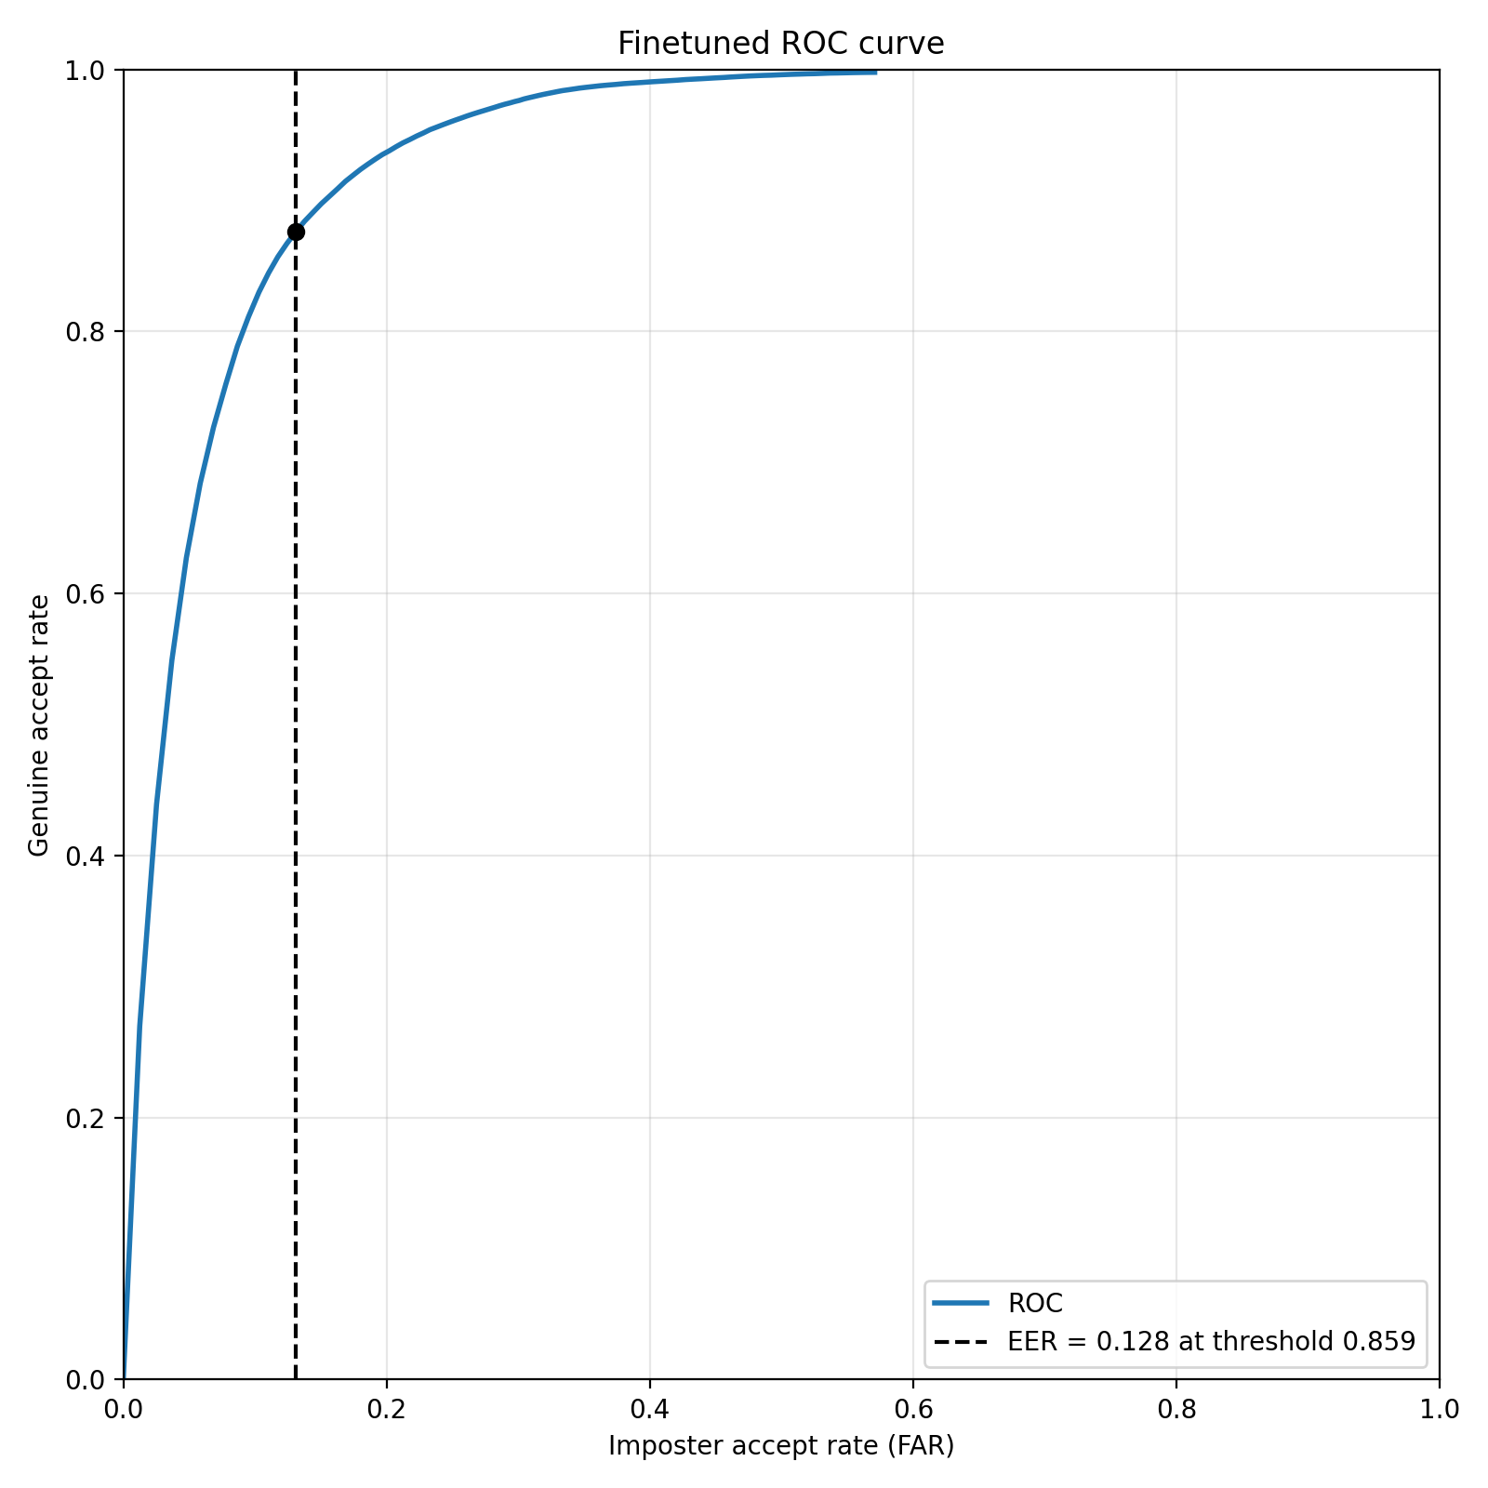
Performance
Fine Tuned:
Threshold: .859
Although in practice it seems to work better at a .95 threshold due to no speaking resulting in a high score
Similarity Score: Calculated using Cosine Similarity

Slide 9
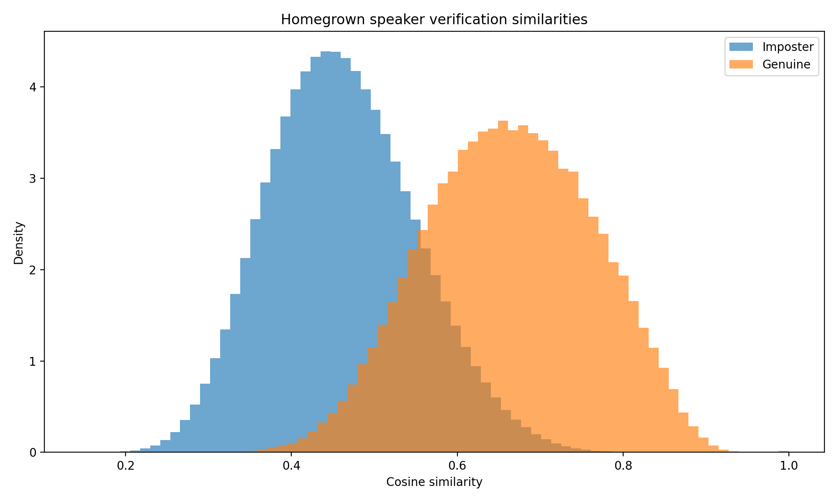
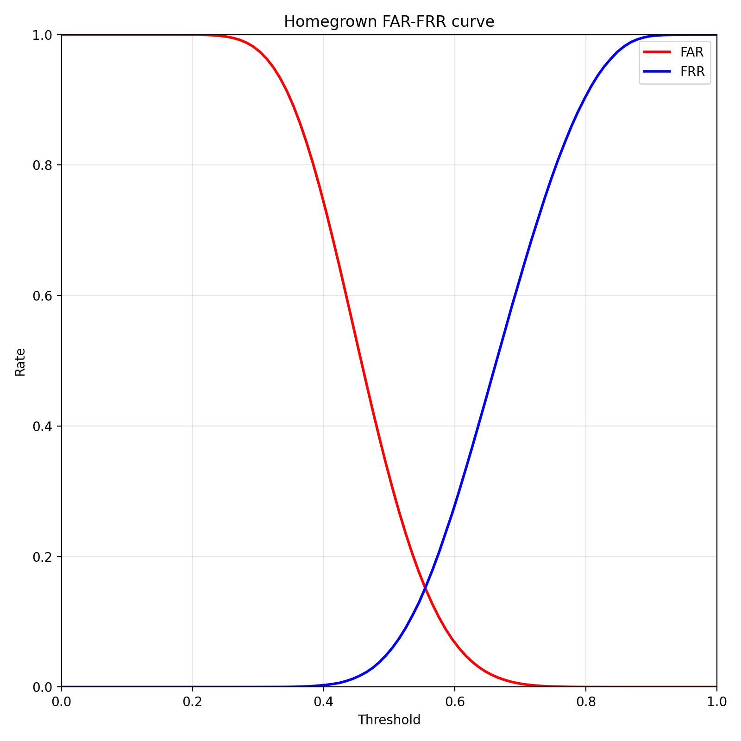
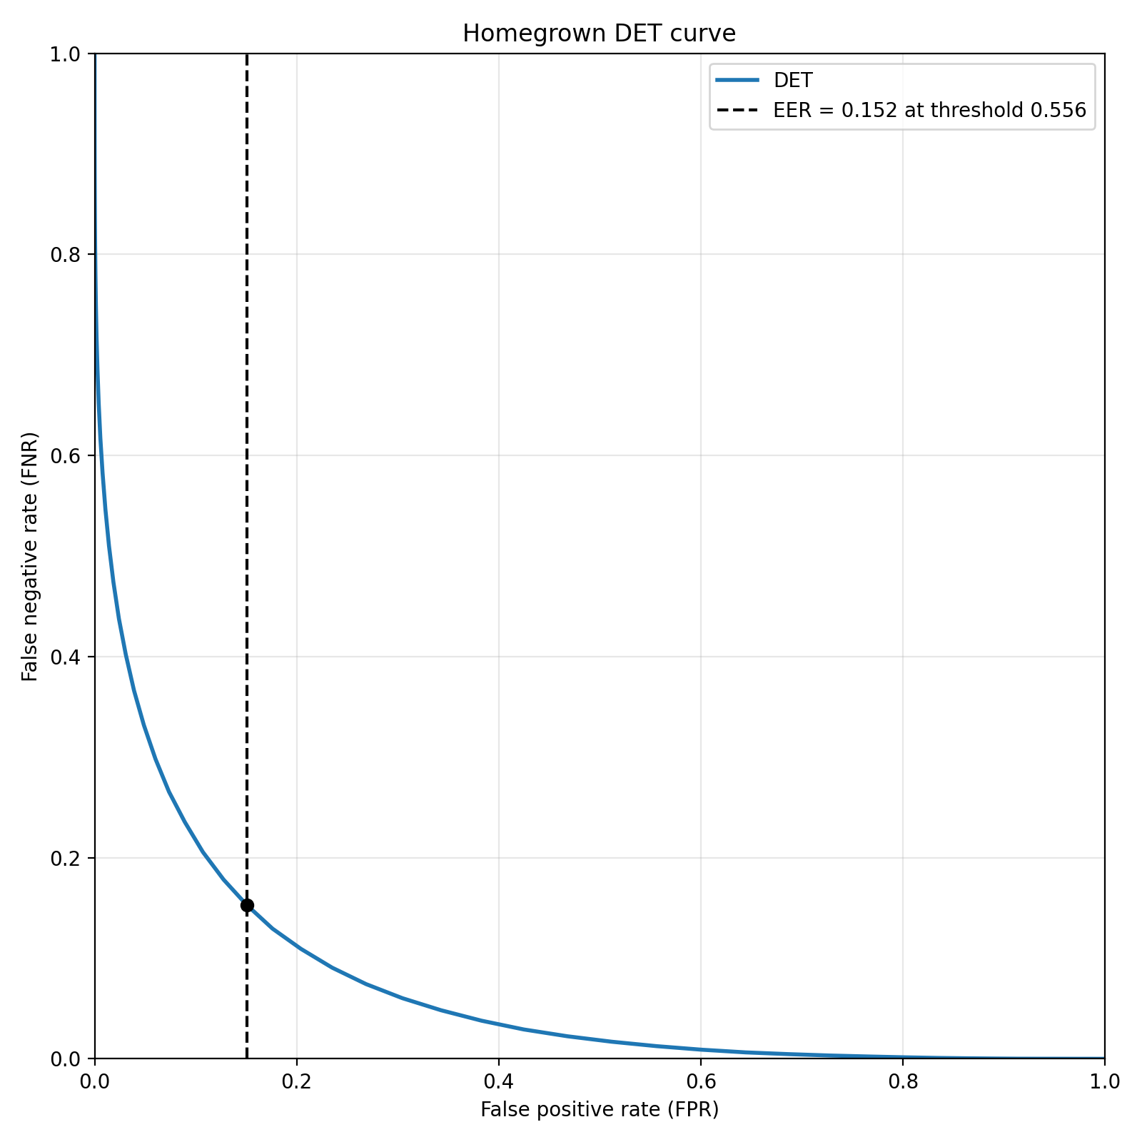
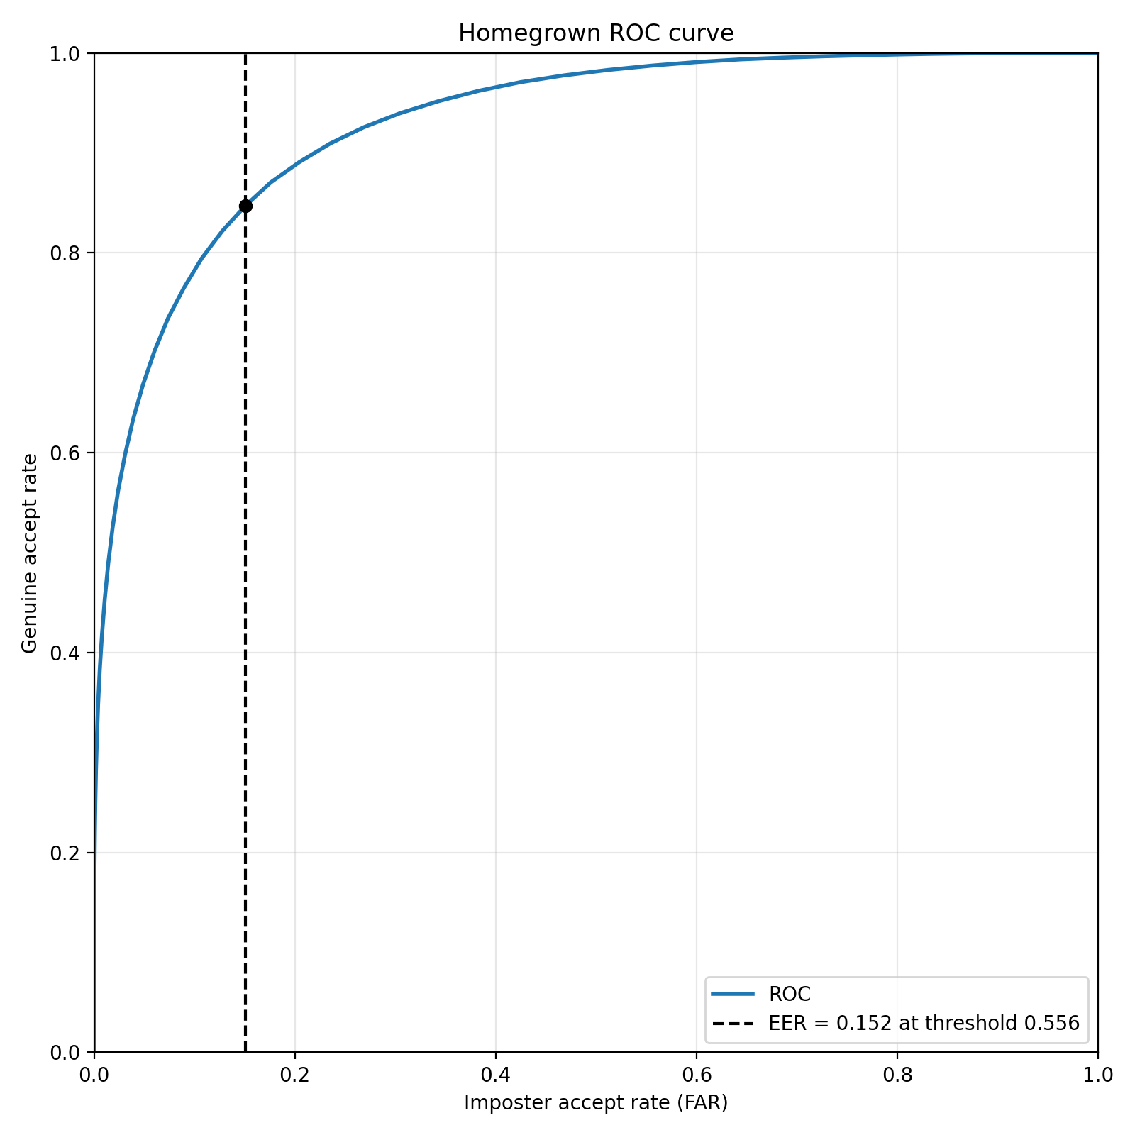
Performance
Home Grown:
Threshold: .556
Although in practice a threshold of around .7 works better due to no speaking resulting in a similarity score of .6
Similarity Score: Calculated using Cosine Similarity

Slide 10
Overall Performance
Our system seems to work relatively well, but there are some places for improvement:
Our system has a harder time differentiating between a male and a male than a male and a female
The fine tuned data set has a much higher similarity score threshold, but our homegrown systems seems to work better, resulting in less false positives.

Slide 11
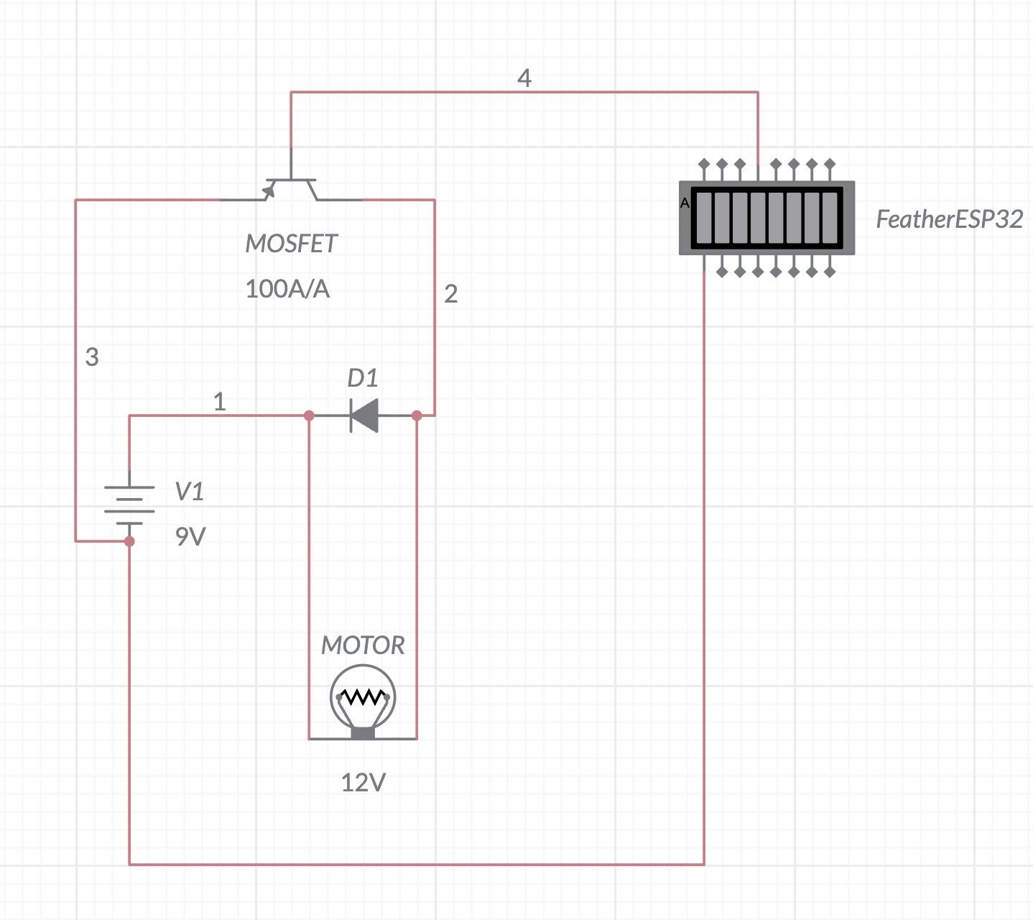
Fun Application
Our system is also connected to feather esp32-s3, which will wait for a single to be sent over USB. When sent it will turn on a Motor based on if the user was in the database.

